Slide 1
MRI ARTIFACTS

Slide 2
What are artifacts?
Artifacts are simply signal misrepresentations that do not correspond to the location of the specific tissue imaged.

Slide 3
What causes artifacts?
The Patient/ Subject
Magnetic Field Inhomogeneity
Machine Hardware

Slide 4
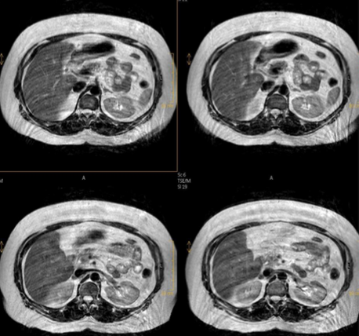
Motion artifact
seen as a smearing across an image.
Primarily caused from patient/subject voluntary movement
Can be caused by involuntary movement such as:
Oesophageal contraction/ vascular pulsation during head and neck imaging
Respiration/ cardiac activity during T-spine/Abdominal imaging
Bowel peristalsis during pelvic imaging

Slide 5
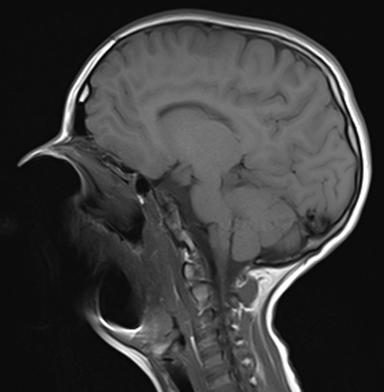
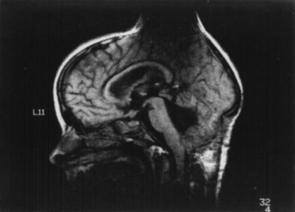
MAGNETIC SUSCEPTABILITY
Artifacts resulting from the presence of metallic objects.
Distorts nearby structures & causes signal loss

Slide 6
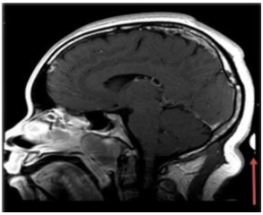
Aliasing/ wrap around artifact
Occurs when tissue outside the field of view is under sampled, causing misregistration of anatomic location.
Easily identified by the superimposition/incorrect location of anatomy

Slide 7
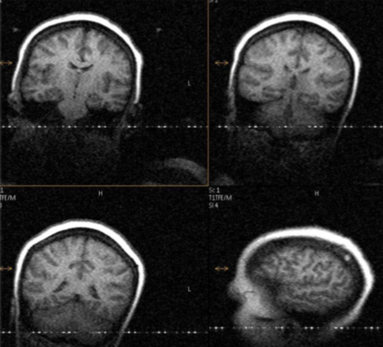
Zipper artifact
A Leak in the RF shielding
Can appear due to inadequate door suction in the MR scan room.

